Slide 1
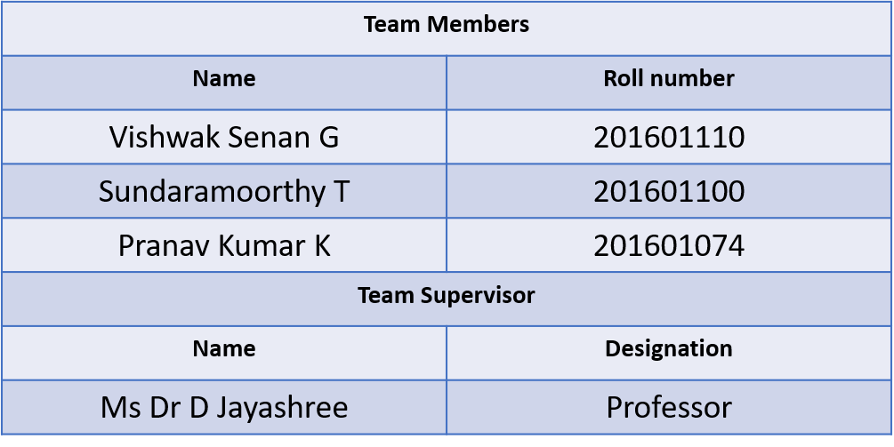
A Novel Algorithm for Automatic Essay Grading using Natural Language Processing Techniques

Slide 2
Abstract
The project gives linguistic support to the users who wants check the authenticity of an English essay. The project’s primary service is hosted in cloud architecture and use API keys to access it securely. This also provides an attractive dashboard to the users to keep track of their scores and their essays. The primary service includes evaluation of
1. Grammar and Spell Check.
2. Sentence Complexity.
3. Style Continuity.
4. Advanced lexical resources.
5. Cohesion and Coherence.

Slide 3
Existing System
Grammarly: Grammarly is an famous software used to word correction and suggestion in the sentence. This product is not capable to do the same for a whole paragraph and for long essays.
ProWritingAid: ProWritingAid provides the users to fix their writing style and eliminate errors by providing a browser extension.
WhiteSmoke: WhiteSmoke is also very efficient English writing and proofreading tool. It indicates the grammar as well as punctuation, spell checking, and writing style suggestions.
Ginger: Ginger is another quite brilliant tool among students, teachers, and bloggers due to its efficient outcomes. The Ginger proofreading tool while typing in the editing boxes such as WordPress or simply go to their site and paste the text.

Slide 4
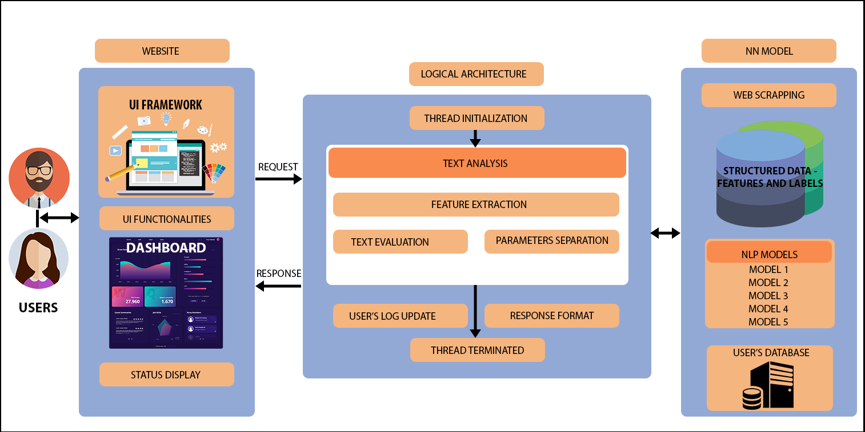
System Architecture

Slide 5
Literature Survey
Paper Title | DOI Number | Inference
Text Classification using Different Feature Extraction Approach | 10.1109/eStream.2019.8732167 | The TF-IDF weighing scheme works by weighing a keyword in any context and assigning the importance to that keyword based on number of times it appears on the document. One of the main drawbacks is the size of the feature set in TF-IDF for text data which equals to the size of the vocabulary across the entire corpus, thus resulting in huge computation on weighing all the words in the data set.
Analysis of Text Categorization Represented with Word Embeddings Using Homogeneous Classifiers | 10.1109/INISTA.2019.8778329 | Word2vec representation learning method with ensemble systems to increase the text classification accuracies. Word embeddings are obtained from the training data through word2vec tool by using shallow neural networks. Two variants of naive Bayes (NB) namely, multivariate Bernoulli NB (MVNB), and multinomial NB (MNB), support vector machine (SVM), and decision tree (DT) are used as single classifiers.

Slide 6
A Fuzzy Approach to Text Classification with Two-Stage Training for Ambiguous Instances | 10.1109/TCSS.2019.2892037 | Traditional fuzzy approaches generally employ a fixed rule (based on maximum membership degree) to provide a distinct class label as an output. Bag of Words (BOW) extracts a bag of distinct words for textual data, and each of the words is used as a feature.
Noisy text categorization | 10.1109/ICMLA.2006.52 | Several categorization approaches have achieved state-of-the-art performance. In this work, we apply support vector machines because there is theoretical evidence that they are especially suitable for data with characteristics typical of document vectors: very high dimensionality (several thousand dimensions), sparseness (few features have values different from zero), high number of relevant features (every term is important even if it appears only a few times), distribution of the term frequencies following Zipf’s Law, and a high level of redundancy (several features account for the same category).

Slide 7
Exploring Feature Selection and Support Vector Machine in Text Categorization | 10.1109/CSE.2013.160 | Text categorization (TC) is a task of automatically assigning a document into a set of predefined categories. This paper explores several methods of feature selection that can be used to reduce high dimensionality of feature space in text documents such as Information Gain, Gain Ratio, Chi-Squares, Mutual Information and Document frequency.
Graph-Based Semantic Learning, Representation and Growth from Text: A Systematic Review | 10.1109/ICOSC.2019.8665592 | Graph-based text representation, in the form of text graphs, is an alternative approach to the Vector-Space Model (VSM), also known as Bag-Of-words (BOW). Text Rank presents a graph-based ranking model, relying on an algorithm derived from Googles PageRank algorithm. Text Rank does not require deep linguistic knowledge. The Text Rank model does not include the cognition and psycholinguistic-based factors which is the main limitation of this technique.

Slide 8
Model 1 Algorithm
Training Algorithm:
Step 1: Download the word collection database from WordNet.
Step 2: Separate the nouns, verbs, pronouns, proverb, adjective, adverb into separate text file from the downloaded database.
Step 3: Load it into the python class train_model using pandas and allocate corresponding label coming from corresponding text file.
Step 4: Separate the labelled database into training and testing database in 7:3 ratio.
Step 5: Apply the feature extraction Bag of Words model on the dataset.
Step 6: Save the trained model
Consuming Algorithm:
Step 1: Get the sentences from the essay by separating sentence end by full stop marks.
Step 2: Apply the trained model 1 on each sentence.
Step 3: If the sentence has any grammatical or spelling error, assign 0. Else 1
Step 4: Repeat Step 3 for all the sentences and count the total number of sentences.
Step 5: Count the total number of 1’s and divide it by the total number of sentences.
Step 6: Multiply the value done on Step 5 by 10 and this score is projected to the user.

Slide 9
Model 2 Algorithm
Training Algorithm
Step 1: Download the lexical database from WordNet.
Step 2: Separate the lexicons into 3 buckets according to their difficulty level.
Step 3: Assign the vector value to each bucket randomly initially using embedding algorithm.
Step 4: Apply Bidirectional LSTM on the word and train the words according to the bucket value.
Step 5: Save the Model
Consumption Algorithm
Step 1: Get the whole essay as the input
Step 2: Tokenize the sentences from the essay
Step 3: Apply the built model on the sentences and get the bucket value for each sentence.
Step 4: Average the bucket vector value from each sentence.
Step 5: Round off and provide the mark for the parameter – Sentence Complexity.

Slide 10
Model 3 Algorithm
Training Algorithm
Step 1: Download the lexicon database from WordNet.
Step 2: Separate the words into various buckets according the style (American, British, Australian English variations).
Step 3: Apply Multinomial Gaussian Mixture Model (GMM) on the bucket to get probability distribution model ready.
Step 4: Save the Model.

Slide 11
Model 3 Algorithm
Consumption Algorithm
Step 1: Get the essay as the input.
Step 2: Tokenize the essay into sentences.
Step 3: Give the numbers
1 – American English
2 – British English
3 – Australian English and so on for each sentence
Step 4: Count the number of 1s, 2s, 3s on the number.
Step 5: Assign the mark according to the table.
Step 6: Repeat step 5 for each number.
Step 7: Average out the mark for each category.
Step 8: Assign the value from step 7 and project it as a mark in Style Continuity.
Continuity of a number | Assign the mark
0% - 20 % | 2
21% - 40 % | 4
41% - 60% | 6
61% - 80% | 8
81% - 100% | 10

Slide 12
Model 4 Algorithm
Training Algorithm
Step 1: Download the lexical resource from WordNet
Step 2: Separate into 5 buckets naming from primitive to advanced.
Step 3: Apply Bag of Words Feature extraction algorithm into these separated database
Step 4: Save the Model
Consumption Algorithm
Step 1: Get the essay as the input
Step 2: Tokenize the essay into list of sentences.
Step 3: For each sentence, find the most advanced word in that sentence
Step 4: Assign the vector value of the most advanced word for that sentence.
Step 5: Repeat step 3 and step 4 for all the sentence.
Step 6: Average out the all the vector value of sentences.
Step 7: Project the step 6 score for the parameter – Lexical Resource

Slide 13
Model 5 Algorithm
Training Algorithm
Step 1: Get the questions database by scrapping ETS GRE Sample Analytical Writing Assessment Questions.
Step 2: Find the subject word in the question and initiate a vector value for all the subject word from the question.
Step 3: Find all the relative words according to the initial vector and build a tree/map for the root vector which the subjective word from question.
Step 4: Build the tree by repeating step 3 considering the current vector value to be root node. Thus, a tree is build depth wise.
Step 5: Save the built model along with its corresponding root node which the question.
Consumption Algorithm
Step 1: Get the essay as the input from the user
Step 2: Tokenize the essay into list of sentences.
Step 3: Get the initial vector value of the question assigned to the user.
Step 4: For each sentence, use the model to get the vector value for each sentence.
Step 5: From the node, traverse into the built model (tree) according the vector value of each sentence.
Step 6: If the path has minimum vector difference, then the sentences are most related to each other.
Step 7: Normalize the difference in the range of 0 – 10 and assign the end normalized value for the parameter coherence and cohesion.

Slide 14
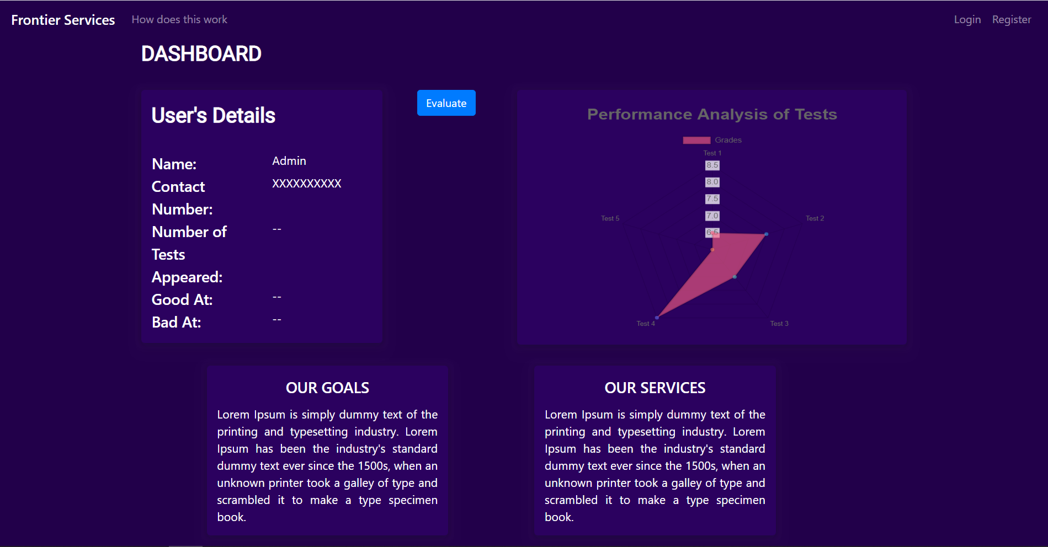
Output Screenshots

Slide 15
